Slide 1
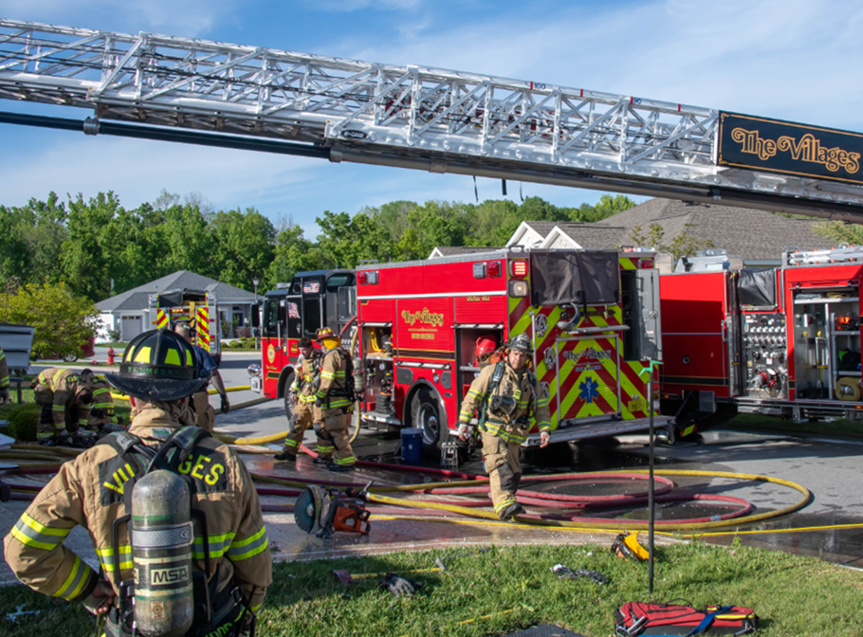
VCCDD Monthly Report January 2026 Fire Chief Brian Twiss
In case of emergency dial 9-1-1
The Villages Public Safety Department is committed to the safety of our community through the delivery of emergency services, fire prevention, and education. We will safeguard life, property and the environment.

Slide 2
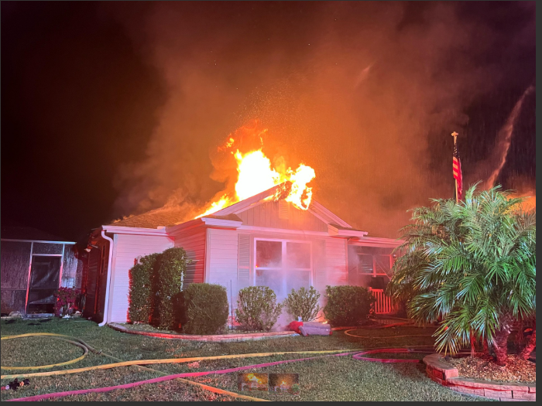
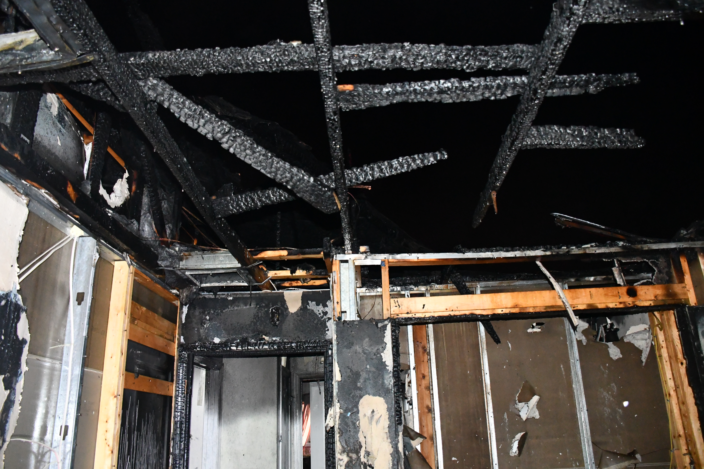
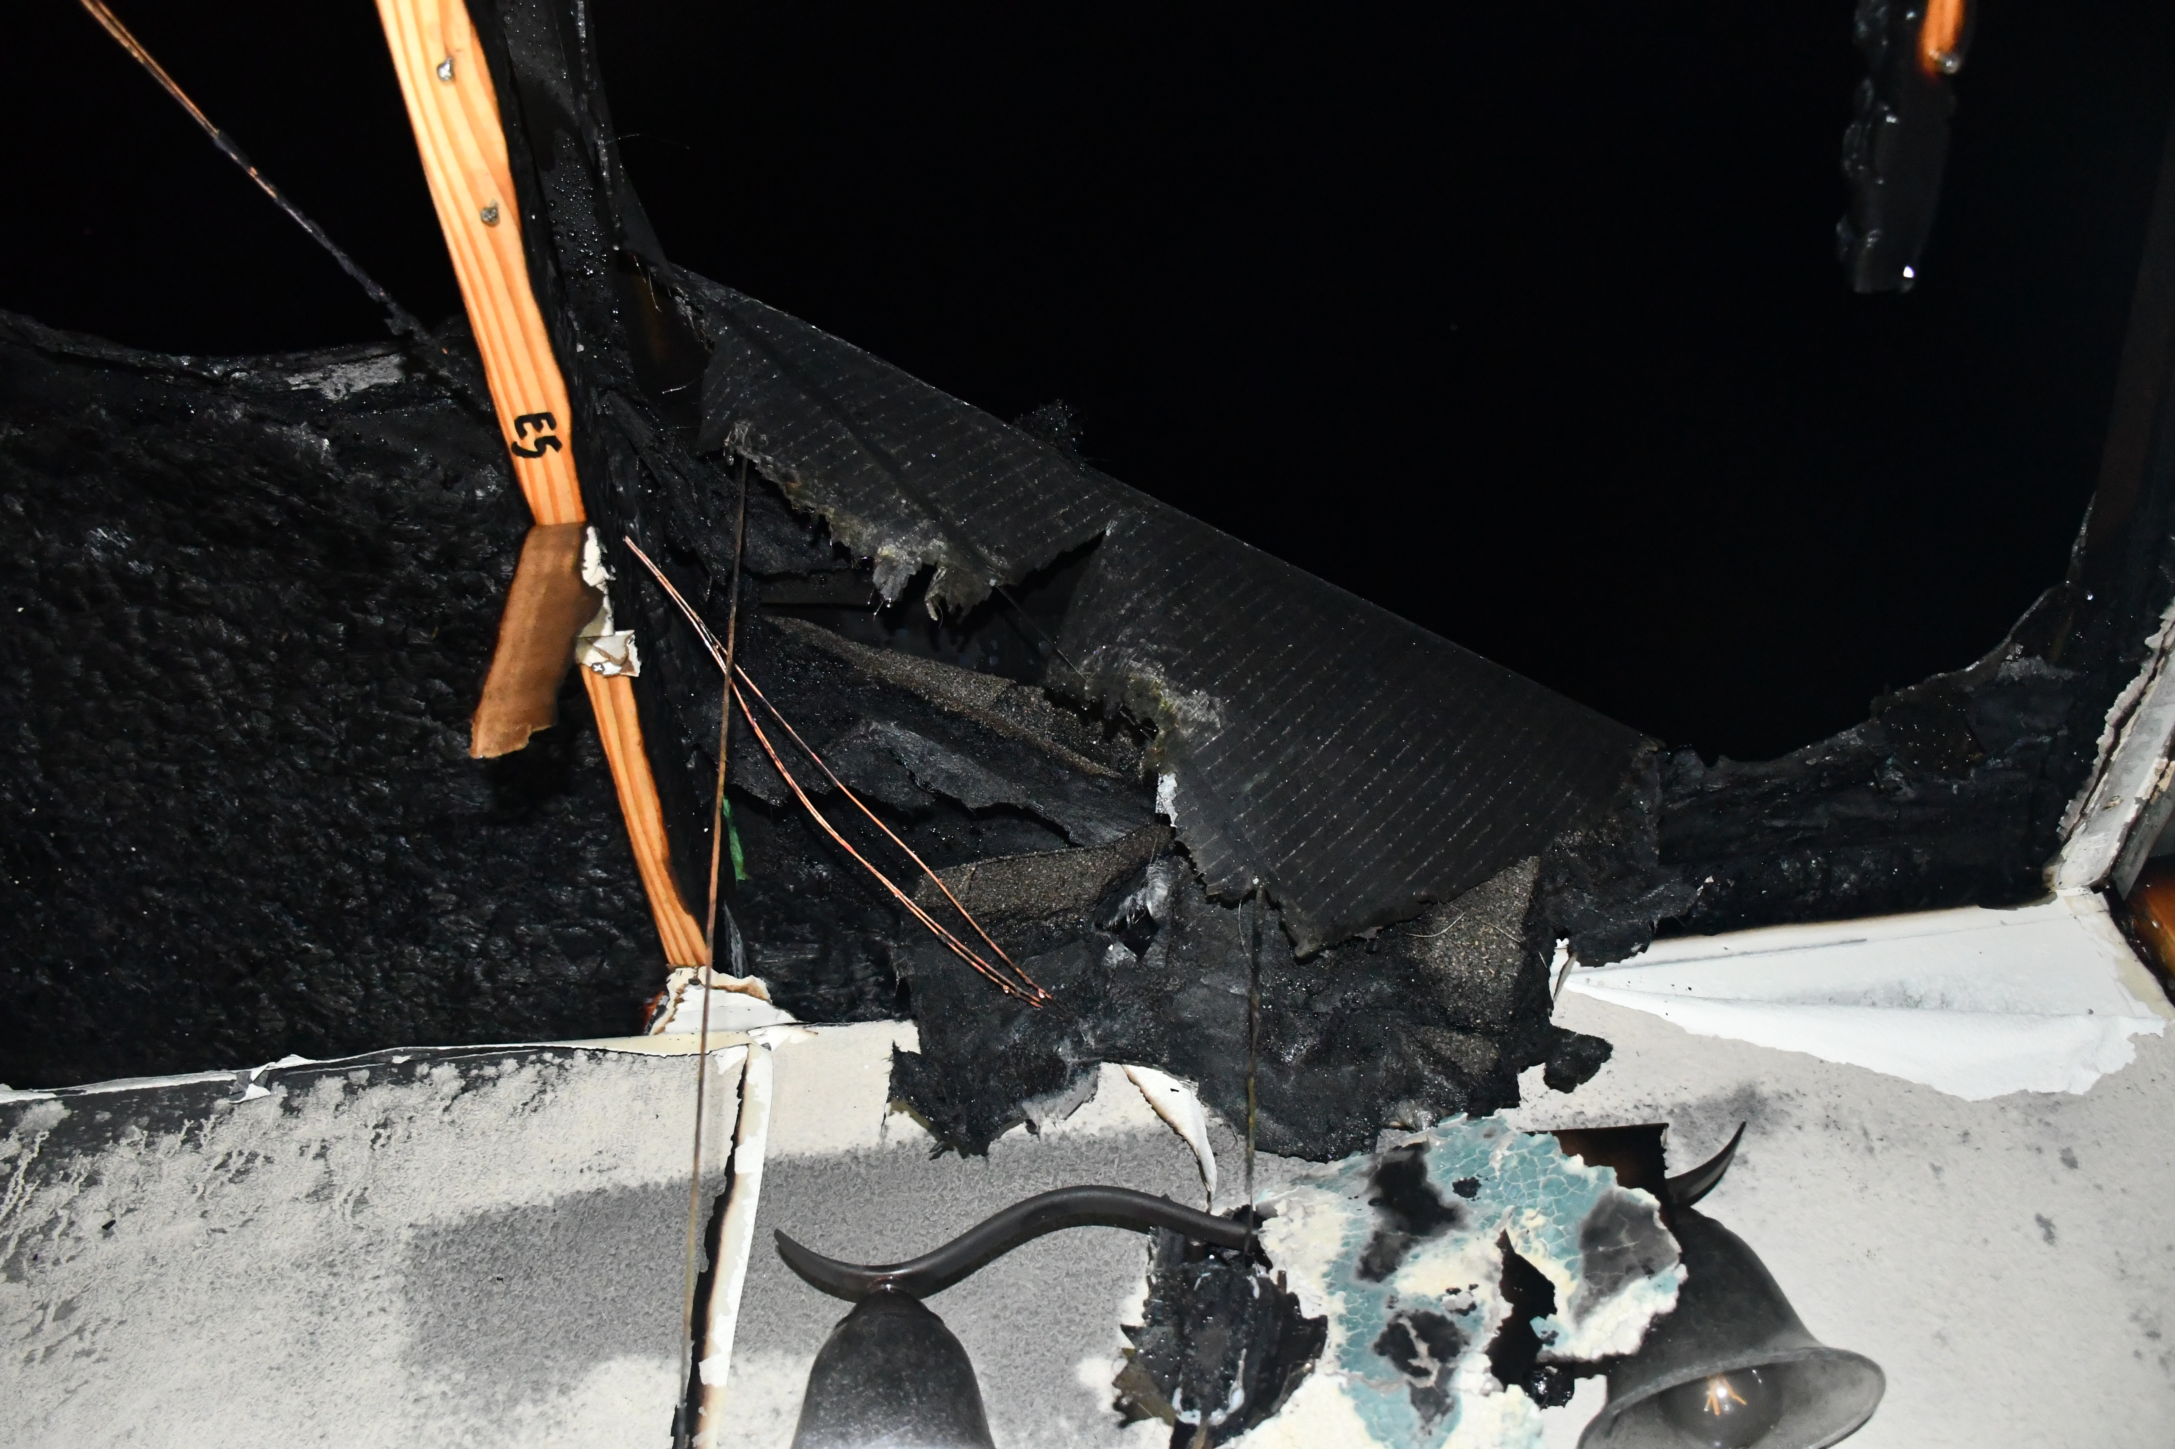
Solar Panel Fire 5542 Parkyn Path
ADD PHOTO HERE – CHECK WITH CHIEFS AND ADD PHOTO THEY APPROVE FOR USE
Response time 0:07:05
Engine 47 1st unit on scene

Slide 3
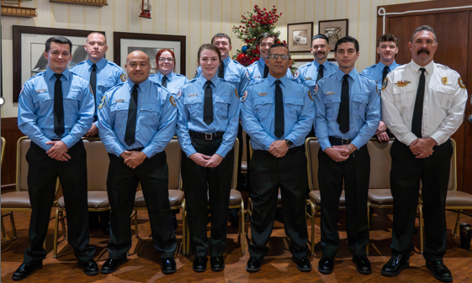
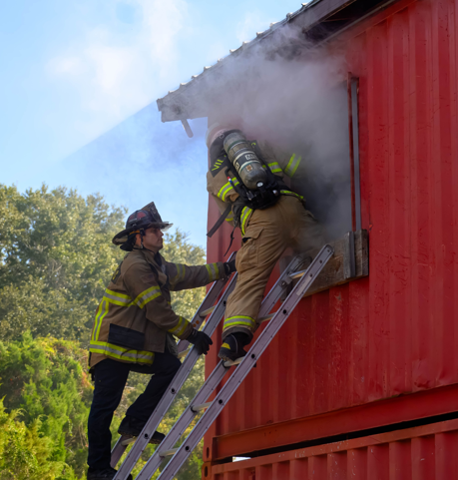
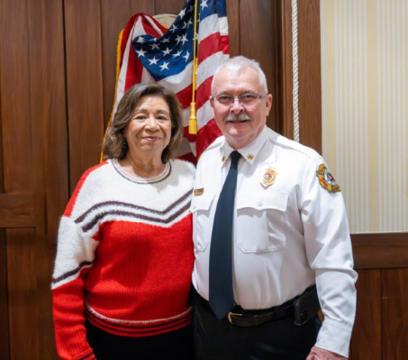
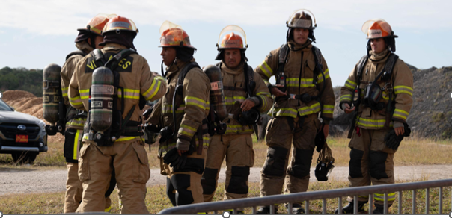
Class 2504 Pinning & Promotional Ceremony January 2, 2026 Lake Miona Recreation Center
12 Graduates and 2 Promotions

Slide 4
December 2025 Incidents
December 2025
Emergency Medical Services Related Responses | 1,974
Fire/Other Responses | 770
Total Incidents | 2,744
1,974 Emergency Medical Services Related Responses
770 Fire & Fire Related Responses
In case of emergency dial 9-1-1
The Villages Public Safety Department is committed to the safety of our community through the delivery of emergency services, fire prevention, and education. We will safeguard life, property and the environment.

Slide 5
December 2025 Average Response Times within The Villages
All Emergency Calls within The Villages Measured in minutes and seconds (mm:ss)
 | Baseline (Actual) Performance | Benchmark (Goal) Performance | Performance Gap (+/- difference)
FY25/26 10/01/25-12/31/25 | 05:35 | 05:15 | +00:15
December 2025 | 05:35 |  | +00:15
November 2025 | 05:35 |  | +00:15
Longterm Goal: Sustained Reduction of First Unit “On Scene” Response Time
In case of emergency dial 9-1-1
The Villages Public Safety Department is committed to the safety of our community through the delivery of emergency services, fire prevention, and education. We will safeguard life, property and the environment.

Slide 6
December 2025 Response Time Fire Units
Percentage of Calls Answered Within
Two (2) - Minute Response Time Intervals
72% of calls were responded to within 8 minutes
In case of emergency dial 9-1-1
The Villages Public Safety Department is committed to the safety of our community through the delivery of emergency services, fire prevention, and education. We will safeguard life, property and the environment.

Slide 7
December 2025 Response Time EMS Units
Percentage of Calls Answered Within
Two (2) - Minute Response Time Intervals
65% of calls were responded to within 8 minutes
In case of emergency dial 9-1-1
The Villages Public Safety Department is committed to the safety of our community through the delivery of emergency services, fire prevention, and education. We will safeguard life, property and the environment.

Slide 8
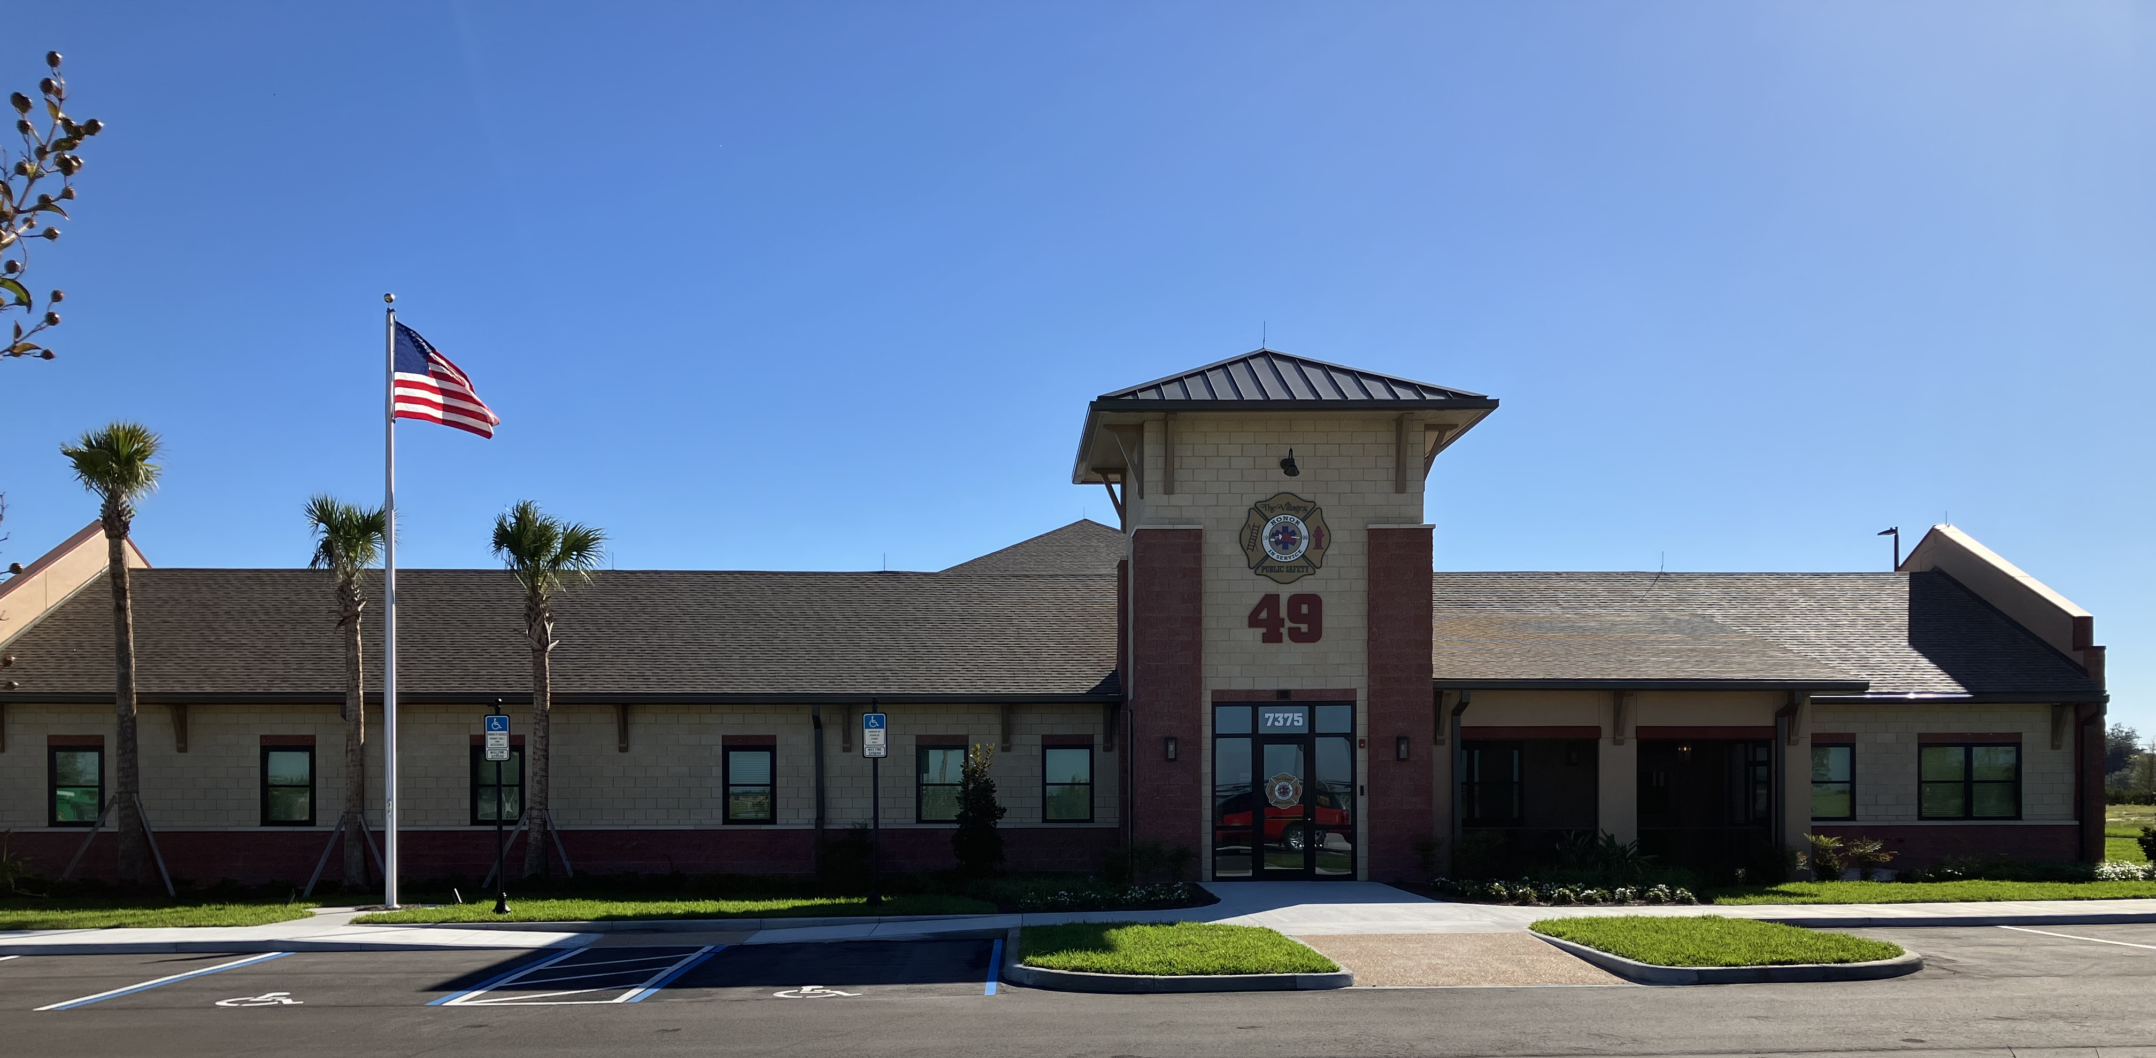
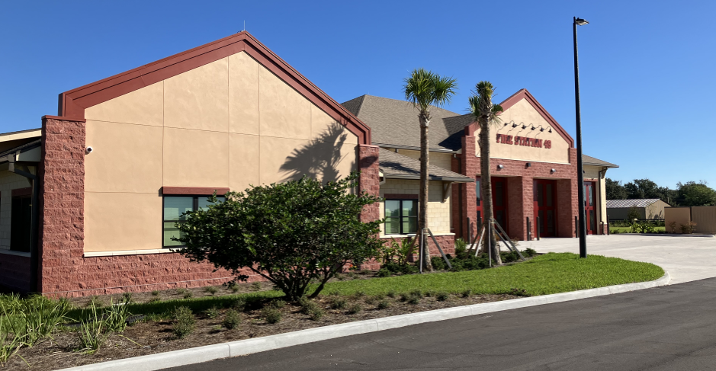
Fire Station #49
Fully Operational in October 2025
18 Assigned Personnel w/Engine & Medic Unit
Push in Ceremony and Open House to be held in Late February or Early March 2026

Slide 9
December 2025 Training Summary
Topic | Total Training Hours (December)
Fire | Online Training: 525 hours Hands on Training: 5,020 hours Total Training Hours: 5,545
EMS | Advent Health Hands On Training: 80 hours New Hire Hands on Training: 990 hours Total Training Hours: 1,070 hours
Technical Rescue | Online Training: 70 hours Hands On Training: 44 hours Total Training Hours: 114 hours
All Training is captured & recorded in a digital “Training Record” System
In case of emergency dial 9-1-1
The Villages Public Safety Department is committed to the safety of our community through the delivery of emergency services, fire prevention, and education. We will safeguard life, property and the environment.

Slide 10
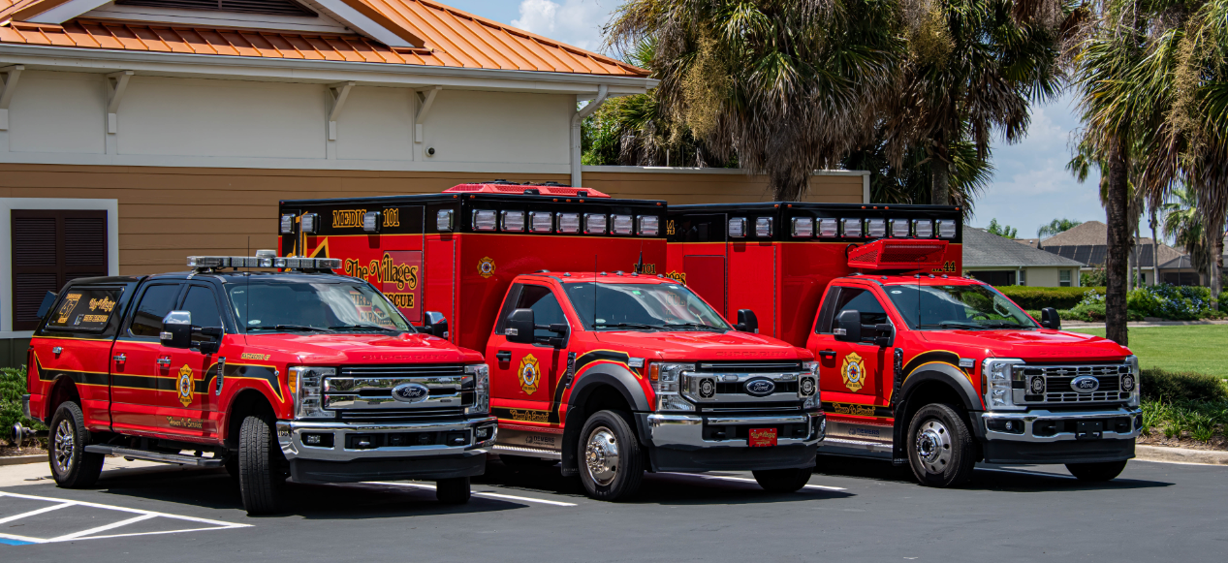
Ambulance Response Statistics
December 2025:
Critical/High Acuity Average Response Time = 7.4 minutes
Moderate/Low Acuity Average Response Time = 7.7 minutes
Total Transports = 1,622
Fiscal Year to Date:
Critical/High Acuity Average Response Time = 7.4 minutes
Moderate/Low Acuity Average Response Time = 7.7 minutes
Total Transports = 4,603
December 2025 & Fiscal Year to Date Ambulance Response Statistics
In case of emergency dial 9-1-1
The Villages Public Safety Department is committed to the safety of our community through the delivery of emergency services, fire prevention, and education. We will safeguard life, property and the environment.

Slide 11
Mobile Stroke Treatment Unit (MSTU)
Total Calls – 98
Admitted to the MSTU – 42
Cancelled On Scene - 23
Cancelled Enroute – 29
Missed Dispatches – 4
Total Acute Interventions – 7
Anticonvulsants – 1
Intubation – 0
ICH Reversal (Reversal of on Intracranial Hemorrhage)– 0
MT (Mechanical Thrombectomy) – 3
IV TNK (clot busting medication given via IV) – 3
In case of emergency dial 9-1-1
The Villages Public Safety Department is committed to the safety of our community through the delivery of emergency services, fire prevention, and education. We will safeguard life, property and the environment.
Notes:
The MSTU provides emergency department level stroke care directly to the patient’s side, saving valuable time and brain tissue.
These same diagnostics and interventions typically take 100 to 160 minutes on average after arrival at most emergency departments.

Slide 12
Mobile Stroke Treatment Unit (MSTU)
Total Calls – 446
Admitted to the MSTU – 203
Refusals - 0
Cancelled On Scene - 121
Cancelled Enroute – 111
Missed Dispatches – 22
Total Acute Interventions – 44
Anticonvulsants – 12
Intubation – 04
ICH Reversal (Reversal of on Intracranial Hemorrhage)– 02
MT (Mechanical Thrombectomy) – 08
IV TNK (clot busting medication given via IV) – 17
In case of emergency dial 9-1-1
The Villages Public Safety Department is committed to the safety of our community through the delivery of emergency services, fire prevention, and education. We will safeguard life, property and the environment.
Notes:
2025 data is from Inception of MSTU = July 2025

Slide 13
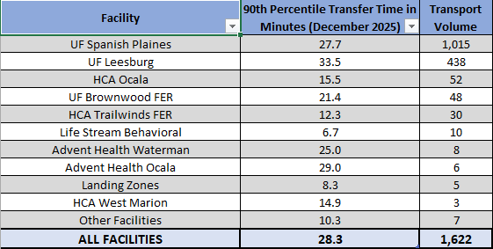
December 2025 Hospital Offload Times
All receiving facilities have worked with us to reduce offload times and maximize ambulance availability
In case of emergency dial 9-1-1
The Villages Public Safety Department is committed to the safety of our community through the delivery of emergency services, fire prevention, and education. We will safeguard life, property and the environment.

Slide 14
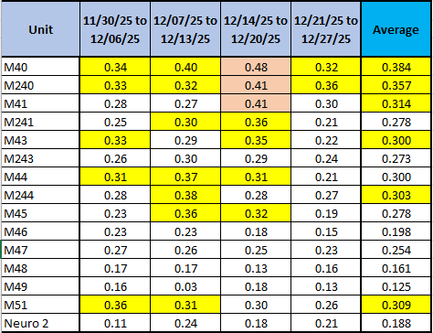
Ambulance Utilization Hours
VPSD maintains Ambulance Utilization Hours in 12-Hour
UHU Analysis
In case of emergency dial 9-1-1
The Villages Public Safety Department is committed to the safety of our community through the delivery of emergency services, fire prevention, and education. We will safeguard life, property and the environment.

Slide 15
2025 Firefighter Health and Safety State Audit
December 19, 2025 – VPSD completed a Safety & Health Compliance Audit by the Florida State Fire Marshal’s Office.
Key Areas Reviewed: Florida Administrative Code 69A-62, Florida Statutes, OSHA standards (as adopted by Florida Administrative Code), NFPA.
Inspection Components: Health & safety programs, workplace safety committees, equipment compliance, apparatus & equipment testing, respiratory protection, personnel medical screening.
Outcome: VPSD received a 100% compliant rating, reflecting strong compliance practices, careful audit preparation, and ongoing internal oversight of firefighter health and safety.
In case of emergency dial 9-1-1
The Villages Public Safety Department is committed to the safety of our community through the delivery of emergency services, fire prevention, and education. We will safeguard life, property and the environment.

Slide 16
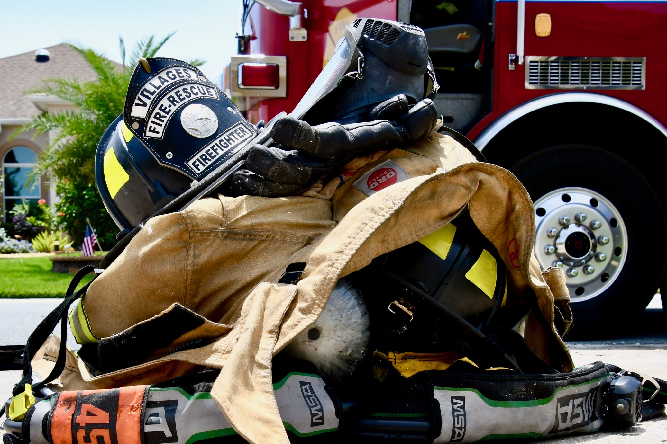
Questions? Thank You for allowing us to serve The Villages
The Villages Public Safety Department is committed to the safety of our community through the delivery of emergency services, fire prevention, and education. We will safeguard life, property and the environment.

Slide 17
Additional Information for The Board

Slide 18
Average Call Processing Time
All Emergency Calls within The Villages Measured in minutes and seconds (mm:ss)
 | Baseline (Actual) Performance | Benchmark (Goal) Performance | Performance Gap (+/- difference)
FY25/26 10/01/25-12/31/25 | 00:21 | 00:35 | -00:14
December 2025 | 00:14 |  | -00:21
November 2025 | 00:10 |  | -00:15
Processing Time is the duration needed for Dispatch to process the call and alert the station(s)
In case of emergency dial 9-1-1
The Villages Public Safety Department is committed to the safety of our community through the delivery of emergency services, fire prevention, and education. We will safeguard life, property and the environment.

Slide 19
Average Turnout Time
All Emergency Calls within The Villages Measured in minutes and seconds (mm:ss)
 | Baseline (Actual Performance | Benchmark (Goal) Performance | Performance Gap (+/- difference)
FY25/26 10/01/25-12/31/25 | 00:39 | 00:45 | -00:06
December 2025 | 00:38 |  | -00:07
November 2025 | 00:42 |  | -00:03
Turnout Time is the duration between when the alarm sounds at the station and the wheels of the apparatus start turning
In case of emergency dial 9-1-1
The Villages Public Safety Department is committed to the safety of our community through the delivery of emergency services, fire prevention, and education. We will safeguard life, property and the environment.

Slide 20
Average Travel Time (Arrival of 1st Unit)
All Emergency Calls within The Villages Measured in minutes and seconds (mm:ss)
 | Baseline (Actual) Performance | Benchmark (Goal) Performance | Performance Gap (+/- difference)
FY25/26 10/01/25-12/31/25 | 05:32 | 05:20 | +00:12
December 2025 | 05:33 |  | +00:13
November 2025 | 05:48 |  | +00:28
Average Travel Time is the duration between when the wheels of the apparatus start turning to the time the first apparatus arrives on scene
In case of emergency dial 9-1-1
The Villages Public Safety Department is committed to the safety of our community through the delivery of emergency services, fire prevention, and education. We will safeguard life, property and the environment.

Slide 21
Call Processing Time at 90th Percentile
All Emergency Calls within The Villages Measured in minutes and seconds (mm:ss)
 | Baseline (Actual) Performance | Benchmark (Goal) Performance | Performance Gap (+/- difference)
FY25/26 10/01/25 –12/31/25 | 00:22 | 01:30 | -01:08
December 2025 | 00:21 |  | -01:09
November 2025 | 00:23 |  | 01:07
In case of emergency dial 9-1-1
The Villages Public Safety Department is committed to the safety of our community through the delivery of emergency services, fire prevention, and education. We will safeguard life, property and the environment.

Slide 22
Travel Time at 90th Percentile (Arrival of 1st Unit)
All Emergency Calls within The Villages Measured in minutes and seconds (mm:ss)
 | Baseline (Actual) Performance | Benchmark (Goal) Performance | Performance Gap (+/- difference)
FY25/26 10/01/25-12/31/25 | 08:18 | 06:00 | +02:18
December 2025 | 08:09 |  | +02:09
November 2025 | 08:14 |  | +02:14
In case of emergency dial 9-1-1
The Villages Public Safety Department is committed to the safety of our community through the delivery of emergency services, fire prevention, and education. We will safeguard life, property and the environment.

Slide 23
December 2025 VPSD Response Data to Areas Outside of The Villages
Emergency Calls ONLY
Measured in minutes and seconds (mm:ss)
Average
90th Percentile
Call Processing | 00:32
Turnout | 00:34
Arrival of 1st Unit | 04:34
Call Processing | 00:43
Turnout | 00:36
Arrival of 1st Unit | 06:04
In case of emergency dial 9-1-1
The Villages Public Safety Department is committed to the safety of our community through the delivery of emergency services, fire prevention, and education. We will safeguard life, property and the environment.

Slide 24
December 2025 Breakdown by Incident Types
Rescue & Emergency Medical Service (EMS) | 1974
Service Call | 456
Good Intent Call | 166
False Alarm & False Call | 56
Fire | 16
Hazardous Condition (no fire) | 72
Misc. | 4
2744 Incidents
In case of emergency dial 9-1-1
The Villages Public Safety Department is committed to the safety of our community through the delivery of emergency services, fire prevention, and education. We will safeguard life, property and the environment.

Slide 25

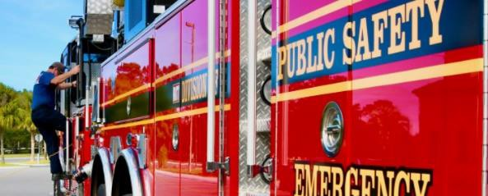
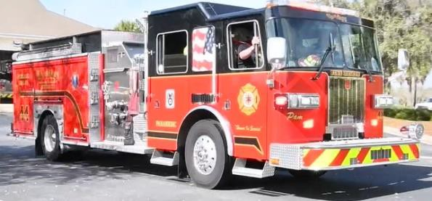
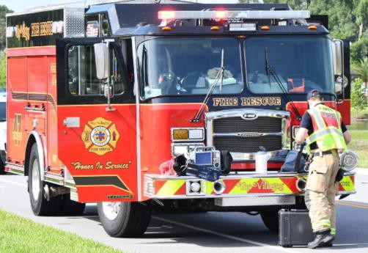
Definitions
Call Processing: time duration needed for Dispatch to process the call and alert the station(s). (“9-1-1, what is the address and nature of your emergency”)
Turnout Time: time duration between when the alarm sounds at the station and the wheels of the apparatus start turning.
Travel Time: time duration between when the wheels of the apparatus start turning to the time the apparatus arrives on scene. (Curb to curb)
Total Response Time: time duration from the beginning of the call at the Dispatch Center to the time personnel/apparatus arrive on scene.
In case of emergency dial 9-1-1
The Villages Public Safety Department is committed to the safety of our community through the delivery of emergency services, fire prevention, and education. We will safeguard life, property and the environment.

Slide 26
FAQ: Percentile Response Reporting
Percentile Response Time Reporting
What is a percentile?
A percentile is a measure in statistics. It shows the value below which a given percentage of observations falls.
For example: the 90th percentile is the value below which 90% of the observations may be found.
Why are we analyzing response times this way?
Analyzing data at a percentile level provides a more in-depth way of looking at the data. We analyze the data at the 90th percentile, as required for accreditation purposes. Looking at the 90th percentile shows us how well we perform 90% of the time.
What is the difference between an average response time and the 90th percentile response time?
The difference between the 90th percentile and an average is: the 90th percentile includes the vast majority of responses—not just half of them.
In case of emergency dial 9-1-1
The Villages Public Safety Department is committed to the safety of our community through the delivery of emergency services, fire prevention, and education. We will safeguard life, property and the environment.

Slide 27
FAQ: Ambulance Utilization Hours
Unit Hour Utilization (UHU) briefly explained is Time on Emergency Calls divided by Available time (24 hour shift).
We strive to keep all units under a UHU of 30% per recommendation of various Fire-Based EMS system studies.
In the example chart below, 7.2 hours on emergency calls would result in a UHU of 30%
(7.2 / 24 = .30)
Task | Required Hours | % of a 24 hour shift
Emergency Calls | 7.2 hours (.30 recommended) | 30%
Fire Company Training | 2 hours (ISO mandated) | 8.3%
Physical Fitness | 1 hour (ISO mandated) | 4.1%
Meals | 1.5 hours | 6.3%
Vehicle Checks & Station Duties | 2 hours | 8.3%
Return from the hospital | 2 hours (20 min x 6 calls) | 8.3%
EMS tasks – reports/training | 2 hours | 8.3%
Sleep/Rest | Call permitting (6.3 hours) | 26.4%
Total Time | 24 hours (1 shift) | 100%
In case of emergency dial 9-1-1
The Villages Public Safety Department is committed to the safety of our community through the delivery of emergency services, fire prevention, and education. We will safeguard life, property and the environment.

